Slide 1

Wastewater Design Challenges for Rural Alaska
Alaska Department of Environmental Conservation
Division of Water
Engineering Support & Plan Review
Gene McCabe
Clint Adler, P.E.

Slide 2
Division of Water
Mission Statement:
  Improve and protect water quality
How?
  Establishes standards for water cleanliness
  Regulates discharges to waters and wetlands
  Provides financial assistance for water and wastewater facility construction and waterbody assessment and remediation
  Trains, certifies, and assists water and wastewater system operators
  Monitors and reports on water quality
Notes:
Bolded items represent items from the standard DOW tasks that ESPR has a role in.

Slide 3
Rural Alaska Challenges
  Logistics – no road system access, compressed construction schedules
  Soil Conditions – silty soils do not drain well
  Proper Operations and Maintenance
  Sub-Arctic and Arctic Climate
  Social, Cultural, and Economic Conditions
  Climate Change
Notes:
Choosing “right” WW technology is more complex that choosing what will work best.
High tech systems work well, but are costly to operate and maintain, and require skilled operators and maintainers.
Extremely high costs of construction and logistics in rural Alaska.
OSDS systems are low maintenance, but do not tend to perform well in the small-lot land planning scenarios of remote villages and the silty soils.
At some point, all systems need to have the solids disposed of, and that is a consistent challenge.
Climate change posing dramatic hydrologic and thermal regime changes – affecting life and viability of designs.

Slide 4
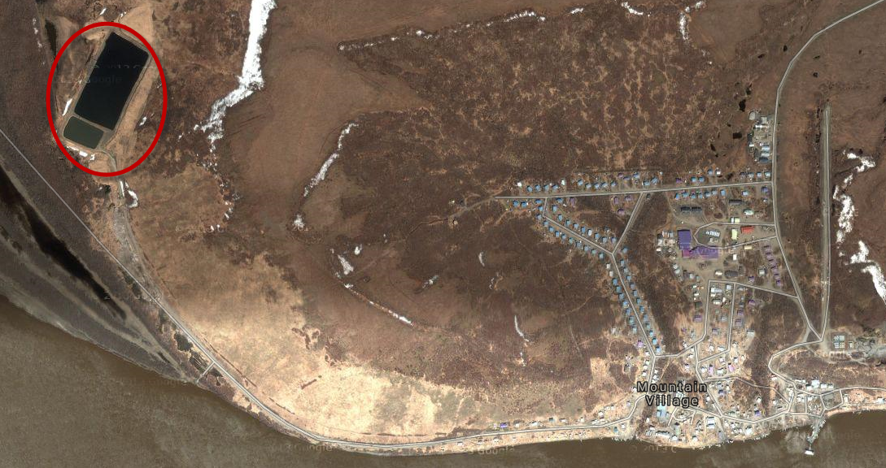
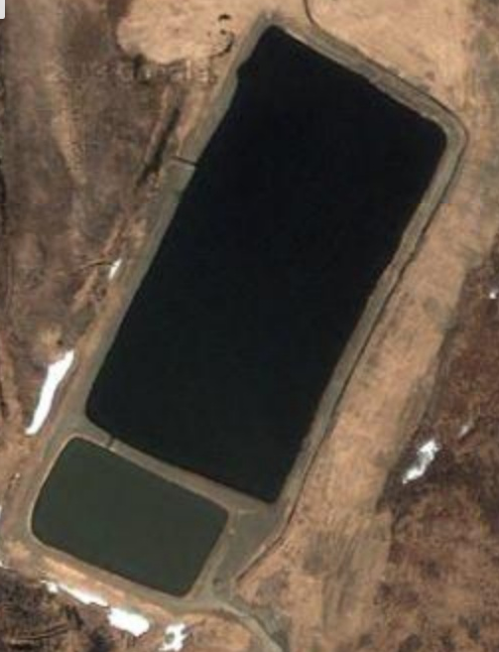
Notes:
Example of a two-cell lagoon system in Mountain Village

Slide 5
So, Why Lagoons?
Tend to work in widest range of soil conditions
Passive wastewater treatment
Accommodates land planning reality
Can generally accept honey-bucket waste
Collection system can be a challenge

Slide 6
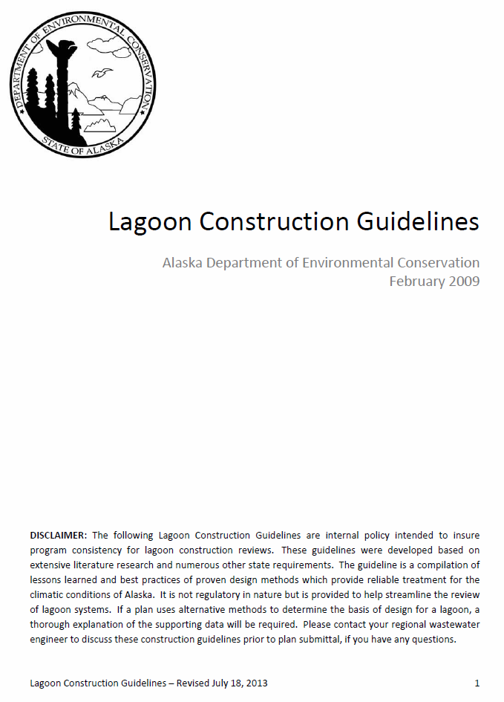

What’s Next?
Develop design standards specifically for rural villages
Establish design performance feedback with stakeholders
Research alternative designs and their effectiveness
Notes:
How to configure the necessary R&D infrastructure?
Planning, Prioritizing, & Project Selection?
Funding?
Roles & Responsibilities?
Implementation & Continuous Improvement?

Slide 7
Questions?
Thank you for your time!
Gene McCabe
Clint Adler, P.E.
Engineering Support & Plan Review
(907) 269-7692
Gene.mccabe@Alaska.gov
Clint.adler@Alaska.gov

